Slide 1
Applied Mechanism Design For Social Good
John P Dickerson
Lecture #23 – 04/20/2021
Lecture #24 – 04/22/2021
Lecture #25 – 04/27/2021
CMSC828M
Tuesdays & Thursdays
2:00pm – 3:15pm

Slide 2
Announcements
Please turn in a project checkup by April 29th
Very simple – can just be a paragraph or two written in your project Slack channel, or a new PDF
Research videos:
Please do make a 10-15 minute video covering a research paper, and/or your research project – something relevant in the space.
This can be done with your group, too!
No exams:
Counting as full %, per syllabus

Slide 3
Today’s Problem
Like most lectures in this class:
m items (initially divisible, later indivisible)
k agents with private values for bundles of items
Either the agents, the items, or both arrive over time.
This class:
Start with fair allocation of multiple divisible resources in a dynamic setting [Kash Procaccia Shah JAIR-2014]
Move to fair dynamic allocation of indivisible items via a restricted bidding language [Aleksandrov et al. IJCAI-2015]
Thanks to: Nisarg Shah (NS), Nick Mattei (NM)

Slide 4
Allocation of Divisible Resources Without Money
Allocating computational resources (CPU, RAM, HDD, etc)
Organizational clusters (e.g., our new Horvitz cluster)
Federated clouds
NSF Supercomputing Centers
We’ll focus on fixed bundles (slots)
Allocated using single resource abstraction
Highly inefficient when users have heterogeneous demands
NS

Slide 5
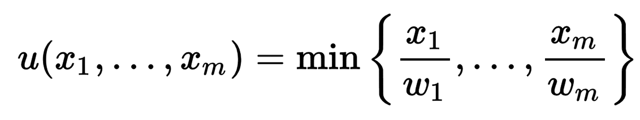
Dominant Resource Fairness (DRF) Mechanisms
[Ghodsi et al. NSDI-11]
Idea: Assume structure on user demands
Proportional demands (a.k.a. Leontief preferences)
Example:
User wishes to execute multiple instances of a job
Each instance needs (1 unit RAM, 2 units CPU)
Indifferent between (2, 4) and (2, 5)
Happier with (2.1, 4.2)
NS

Slide 6
Dominant Resource Fairness (DRF) Mechanisms
Dominant resource: resource the agent has the biggest share of out of all resources available:
16 CPUs, 10 GB available, user allocated 4 CPUs, 8 GB
Dominant resource is GB, because 4/16 CPU < 8/10 GB
Dominant share: fraction of dominant resource allocated
Above, dominant share is 8/10 = 80%

Slide 7

Static DRF Mechanism
Dominant Resource Fairness = equalize largest shares (a.k.a. dominant shares)
Total
1
2
Dominant resource (for an agent): resource for which the agent’s task requires the largest fraction of total availability
NS

Slide 8
Problem with DRF
[Kash Procaccia Shah JAIR-14]
Assumes all agents are present from the beginning and all the job information is known upfront
Can relax this to dynamic setting:
Agents arriving over time
Job information of an agent only revealed upon arrival
This paper initiated the study of dynamic fair division
Huge literature on fair division, but mostly static settings
Still very little work on fair division in dynamic environments!
NS

Slide 9
Formal Dynamic Model
Resources are known beforehand
Agents arrive at different times (steps), do not depart
Total number of agents known in advance
Agents’ demands are proportional, revealed at arrival
Each agent requires every resource
Simple dynamic allocation mechanism:
At every step k
Input: k reported demands
Output: An allocation over the k present agents
Terminate after final agent arrives
Irrevocability of resources!
NS

Slide 10
Desiderata
Properties of DRF, aims for a dynamic generalization
Property | Static (DRF) | Dynamic (Desired)
Envy freeness | EF: No swaps. | EF: No swaps at any step.
Sharing incentives | SI: At least as good as equal split. | SI: At least as good as equal split to every present agent at all steps.
Strategyproofness | SP: No gains by misreporting. | SP: No gains at any step by misreporting.
Pareto optimality | PO : No “better” allocation. | DPO: At any step k, no “better” allocation using k/n share of each resource.
NS

Slide 11
Impossibility Result
Envy freeness + Dynamic Pareto optimality = Impossible
DPO requires allocating too much
Later agents might envy earlier agents
Dropping either of them completely → trivial mechanisms!
Drop EF, trivial DPO mechanism ??????????
Drop DPO, trivial EF mechanism ??????????
Relax one at a time …
NS

Slide 12
1) Relaxing Envy Freeness
Envy impossible to avoid if efficiency (DPO) required
But unfair if an agent is allocated resources while being envied
Dynamic Envy Freeness (DEF)
If agent i envies agent j, then j must have arrived before i did, and must not have been allocated any resources since i arrived
Comparison to Forward EF [Walsh ADT-11]: An agent may only envy agents that arrived after her
Forward EF is strictly weaker
Trivial FEF mechanism ???????????????
NS
Notes:
Dictatorship – give all resources to first agent to arrive, end.

Slide 13
Mechanism: Dynamic-DRF
Agent k arrives
Start with (previous) allocation of step k-1
Keep allocating to all agents having the minimum “dominant” (largest) share at the same rate
Until a k/n fraction of at least one resource is allocated
(A constrained “water-filling” algorithm.)
Dynamic-DRF satisfies relaxed envy freeness (DEF) along with the other properties (DPO, SI, SP).
THEOREM
NS
Notes:
Water-filling image from ppt|craft.

Slide 14
Dynamic-DRF illustrated
3 agents, 2 resources
(1,ε)
(ε,1)
(1,ε)
Total
1
2
3
NS

Slide 15
2) Relaxing DPO
Sometimes total fairness desired
Naïve approach: Wait for all the agents to arrive and then do a static envy free and Pareto optimal allocation
Can we allocate more resources early?
Cautious Dynamic Pareto Optimality (CDPO)
At every step, allocate as much as possible while ensuring EF can be achieved in the end irrespective of the future demands
Cautious-LP: a constrained water-filling mechanism
THEOREM
Cautious-LP satisfies relaxed dynamic Pareto optimality (CDPO) along with the other properties (EF, SI, SP).
NS

Slide 16
Experimental Evaluation
Initial static DRF paper has had a big effect in industry.
Now: Dynamic-DRF and Cautious-LP under two objectives:
Maximize the sum of dominant shares (utilitarian, maxsum)
Maximize the minimum dominant share (egalitarian, maxmin)
Comparison with provable lower and upper bounds
Data: traces of real workloads on a Google compute cell
7-hour period in 2011, 2 resources (CPU and RAM)
code.google.com/p/googleclusterdata/wiki/ClusterData2011_1
NS

Slide 17
Experimental Results
Maxsum objective 100 agents
Maxmin objective 100 agents
NS

Slide 18
Discussion
Relaxation: allowing zero demands
Trivial mechanisms for SI+DPO+SP no longer work
Open question: possibility of SI+DPO+SP in this case
Allowing agent departures and revocability of resources
No re-arrivals → same mechanism (water-filling) for freed resources
Departures with re-arrivals
Pareto optimality requires allocating resources freed on a departure
Need to revoke when the departed agent re-arrives
NS

Slide 19
What about Indivisible items?
[Aleksandrov et al. IJCAI-2015]
Recall: even in the static setting, an envy-free allocation may not exist (we’ll talk about this more next week):
So: change our desiderata from previous part of lecture
New model:
k agents, each with private utility for each of m items
Items arrive one at a time
Agents bid “like” or “dislike” on items when they arrive
Mechanism must assign items when they arrive

Slide 20
The Like Mechanisms
LIKE Mechanism:
Item arrives
Some subset of agents bid “Like”
Mechanism allocates uniformly at random amongst “Likers”
BALANCED-LIKE Mechanism:
Same as LIKE, but allocates randomly amongst “Likers” that have received the fewest overall number of items
Guarantees agent receives at least 1 item per every k she Likes
Bad properties ?????????

Slide 21
Strategy Proofness
LIKE Mechanism ??????????
Yes, always Like if utility is nonzero
THEOREM
LIKE is strategy proof for general utility functions

Slide 22
Strategy Proofness
BALANCED-LIKE Mechanism ?????????
THEOREM
BALANCED-LIKE is not SP, even for 0/1 utilities
EV of truthful A1 vs. truthful A2 and A3 ??????
0.5: a → not b → not c, 0.5*1 = 1/2
0.5: not a → …
0.5: not b → c = 0.5*0.5*1 = 1/4
0.5: b → 0.5 c = 0.5*0.5*(1 + 0.5*1) = 3/8
EV = 1/2 + 1/4 + 3/8 = 9/8
True private utilities
Items | a | b | c
Agent 1 | 1 | 1 | 1
Agent 2 | 1 | - | 1
Agent 3 | - | 1 | -
Manipulation:
Don’t bid on item a → Agent 2 gets a
Bid on b → 0.5: get b = 1/2
Bid on c → have b? → 0.5: get c; not b? → c
EV = 1/2 + 1/2 + 1/4 = 5/4 > 9/8
Arrivals: a → b → c

Slide 23
Strategy Proofness
THEOREM
BALANCED-LIKE is SP with 2 agents and 0/1 utilities
THEOREM
BALANCED-LIKE is not SP with 2 agents and general utilities (even for the case of only 2 items)
(See the paper.)

Slide 24
SO the system can be gamed …
What does this do social welfare? Fairness?
Authors were motivated by working with Food Bank Australia, where unsophisticated dispatchers bid on food
Strong case to be made to care about both objectives!
In general, bidding strategically is quite bad for social welfare:
Compare sincere behavior against set of Nash profiles
THEOREM
There are instances with 0/1 utilities and k agents where:
the {egalitarian, utilitarian} welfare with sincere play under
{LIKE, BALANCED-LIKE} …
… is k times the corresponding welfare under a Nash profile.
Notes:
Egalitarian here is min utility across all agents.

Slide 25
What about Envy?
Ex-ante envy freeness: over all possible outcomes, do I expect to be envious?
Ex-post envy freeness: after items are allocated, am I envious?
Is LIKE ex-ante E-F under 0/1 utilities ??????????
Yes. Each item’s allocation is independent of past allocations.
Assume first m-1 allocations are EF. Item m arrives. Each of j < k agents with utility 1 receives item in 1/j of possible worlds. Still EF.
Is LIKE ex-post E-F under 0/1 utilities ??????????
No. 2 agents, utility 1 for all m items. Agent 1 gets lucky and receives all m items (P = ½^m > 0); unbounded envy!

Slide 26
What about Envy?
Using similar arguments, paper shows that BALANCED-LIKE under 0/1 utilities is:
Ex-ante envy free
Bounded ex-post envy free (with at most 1 unit of envy)
Quick summary:
Effect of strategic behavior can be very bad for efficiency!
Under sincere play, mechanisms seem pretty fair …
... under unit preferences for items
≠

Slide 27
What to Do?
Motivated by a food bank problem:
Participants may be altruistic, social-welfare-minded, and relatively unsophisticated → sincere behavior?
Bundle items so participants value then roughly equally
Equivalent to 0/1 utilities, can leverage fairness properties
Problems:
Bidders still have self interest
Bundling items takes time (and produce spoils quickly)
Bundling items may not always be possible

Slide 28
Combinatorial Assignment Problems & Course Match
Thanks to: John Kubiatowicz (JK)

Slide 29
Recall: DRF
Proportional demands (a.k.a. Leontief preferences)
Dominant resource: resource the agent has the biggest share of out of all resources available:
16 CPUs, 10 GB available, user allocated 4 CPUs, 8 GB
Dominant resource is GB, because 4/16 CPU < 8/10 GB
Dominant share: fraction of dominant resource allocated
Above, dominant share is 8/10 = 80%
DRF: application of max-min fairness to dominant shares
Equalize the dominant share amongst agents

Slide 30
Static DRF Mechanism
Dominant Resource Fairness = equalize largest shares (a.k.a. dominant shares)
Total
1
2
NS

Slide 31
Alternative: Make a market
Competitive Equilibrium from Equal Incomes (CEEI):
Agents report their preferences over sets of items
Give agents an equal budget of funny money
Computer finds prices that clear the market
That is, prices such that when each agent chooses its most favored set that it can afford, the market clears
Assign all resources to agents based on their demands and these computed prices

Slide 32
CEEI Example: Divisible Resources
Supply: {1 cake, 1 doughnut}
Two agents, both with $1 (funny money), capacity of 1
A: cake = 1/2, doughnut = 1
B: cake = 1/4, doughnut = 1
Market clearing prices: cake = $2/5, doughnut = $8/5
A wants to max 1/2c + 1d s.t. c + d < 1 p_{c}c + p_{p}d <= 1
B wants to max 1/4c + 1d s.t. c + d < 1 p_{c}c + p_{p}d <= 1
??????????
Max: ½ cake, ½ doughnut
Max: ½ cake, ½ doughnut (and many others – clearinghouse chooses!)

Slide 33
CEEI Properties
Envy-free ????????
Yes! Given the prices, you bought the best bundle you could afford
If you envy somebody else’s bundle, you could’ve purchased it!
Pareto-efficient ????????
Yes! Market is cleared → taking a Pareto step involves taking a resource from one agent and giving it to somebody new … but this lowers their utility by above
Strategy proof ????????
No! Intuition: CEEI clears the market → can game the system by requesting more underutilized resources

Slide 34
DRF vs CEEI
A1: <1 CPU, 4 GB> A2: <3 CPU, 1 GB>
DRF more fair, CEEI better utilization
A1: <1 CPU, 4 GB> A2: <3 CPU, 2 GB>
A2 increased her share of both CPU and memory
Dominant Resource Fairness
Competitive Equilibrium from Equal Incomes
Dominant Resource Fairness
Competitive Equilibrium from Equal Incomes
100%
100%
100%
100%
66%
66%
91%
user 1
80%
50%
50%
user 2
50%
50%
66%
66%
55%
60%
0%
0%
0%
0%
CPU RAM
CPU RAM
CPU RAM
CPU RAM
JK
Notes:
Nash: .49948 u1:.5161 u2:0.9677 --

Slide 35
CEEI for Indivisible items?
Two agents
Capacity: 2
Both agents will share the same preference profile:
Market clearing prices ????????
Don’t exist! For any price, for any item, either both agents demand that item or both do not.
Small changes in price can cause big changes in demand
>
>
>
>
>
>
>
>

Slide 36
Approximate-CEEI
Can we tiebreak somehow?
Idea: give agents slightly different, but roughly equal budgets
For each agent, draw budget from [1, 1 + B)
0 < B < min( 1/m, 1/(k-1) ) – k is capacity of agent
Note: if B = 0, this is just CEEI
Still “feels fair” – random winners and losers in the budget draw, and the playing ground is still roughly equal.

Slide 37
A-CEEI For Indivisible Items
Two agents
Capacity: 2
Agent 1’s budget: $1.2
Agent 2’s budget: $1
Agent 1: Agent 2:
= $1.10
= $0.80
= $0.20
= $0.10
????????????

Slide 38
A-CEEI: Properties
Always exists if B > 0 (need unequal budgets)
The market approximately clears:
There exist prices that clear the market to within an error of at most √k*m/2
Error does not depend on the number of participants → error goes to zero as a fraction of the underlying endowment
Approximately strategy proof
“Strategy-proof in the large"
Bounded envy free
Very difficult to compute!
??????????????

Slide 39
When do Fair Allocations Exist And How Do We find Them?
Thanks to: Yonatan Aumann (YA), Ariel Procaccia (AP), Shengyu Zhang (SZ)

Slide 40
Cutting a Divisible Cake: Model
Division of a heterogeneous divisible good
The cake is the interval [0,1]
Set of agents N = {1,...,n}
Each agent has a valuation function V_{i} over pieces of cake
Additive: if X∩Y=∅ then V_{i}(X)+V_{i}(Y) = V_{i}(X∪Y)
∀i∈N, V_{i}([0,1]) = 1
Find an allocation A = A₁,...,A_{n}
The cake is a metaphor.

Slide 41
Fairness Definitions
Proportionality: ∀i∈N, V_{i}(A_{i}) ≥ 1/n
Envy-freeness: ∀i,j∈N, V_{i}(A_{i}) ≥ V_{i}(A_{j})
Assuming free disposal the two properties are incomparable
Envy-free but not proportional: ????????????
Throw away cake!
Proportional but not envy-free:
1/3
1/2
1
1/6
1

Slide 42
Deterministic algorithms
Current research in cake cutting: design truthful, envy free, proportional, and tractable cake cutting algorithms
Requires restricting the valuation functions
Lower bounds for envy-free cake cutting (see, e.g., [Procaccia, 2009, 2014])
Valuation V_{i} is piecewise uniform if agent i is uniformly interested in a piece of cake
E.g., interested uniformly in [0,0.5] but not (0.5,1.0]
THEOREM
Assuming that the agents have piecewise uniform valuations, then there is a deterministic algorithm that is truthful, proportional, envy-free, and polynomial-time.

Slide 43
Randomized algorithms
A randomized algorithm is universally envy-free (resp., universally proportional) if it always returns an envy-free (resp., proportional) allocation
A randomized algorithm is truthful in expectation if an agent cannot gain in expectation by lying
→ Looking for universal fairness and truthfulness in expectation

Slide 44
A Randomized Cake Cutting Protocol
A partition X₁,...,X_{n} is perfect if for every i, k, V_{i}(X_{k})=1/n
Algorithm:
Find a perfect partition X₁,...,X_{n}
Give each player a random piece
Observation [Mossel&Tamuz 2010]: algorithm is truthful in expectation, universally E-F and universally proportional
Proof: if agent i lies it may lead to a partition Y₁,...,Y_{n}, but Σ_{k} (1/n)V_{i}(Y_{k}) = (1/n) Σ_{k} V_{i}(Y_{k}) = 1/n
It is known that a perfect partition always exists [Alon 1987]
Lemma: if agents have piecewise linear valuations then a perfect partition can be found in polynomial time
???????????

Slide 45
Counting Cuts & Queries
Algorithms for different variants of the problem:
Finite Algorithms
“Moving knife” algorithms
Lower bounds on the number of steps required for divisions
(see [Procaccia CACM-14] for an easy-to-read discussion)
Until very recently it was unknown if there was a bounded (in terms of queries to agents’ valuation functions, and in terms of cuts) and E-F cake cutting algorithm for 4 or more players
[Aziz and Mackenzie STOC-16]: bounded (231 cuts) for 4 players
[Aziz and Mackenzie FOCS-16]: bounded (O(n^n^n^n^n^n) queries) for n players

Slide 46
Cut and Choose
Two agent case!
Alice
Bob
Alice likes the candies
Bob likes the base
Alice cuts in “her” middle
Bob chooses
Proportional
Envy free
Equitable
Proportional ??????
Envy free ??????

Slide 47
Cut And Choose
Three agent case!
Stage 0: Player 1 divides into three equal pieces
(According to her valuation)
Player 2 trims the largest piece s.t. the remaining is the same as the second largest.
The trimmed part is called Cake 2; the other forms Cake 1

Slide 48
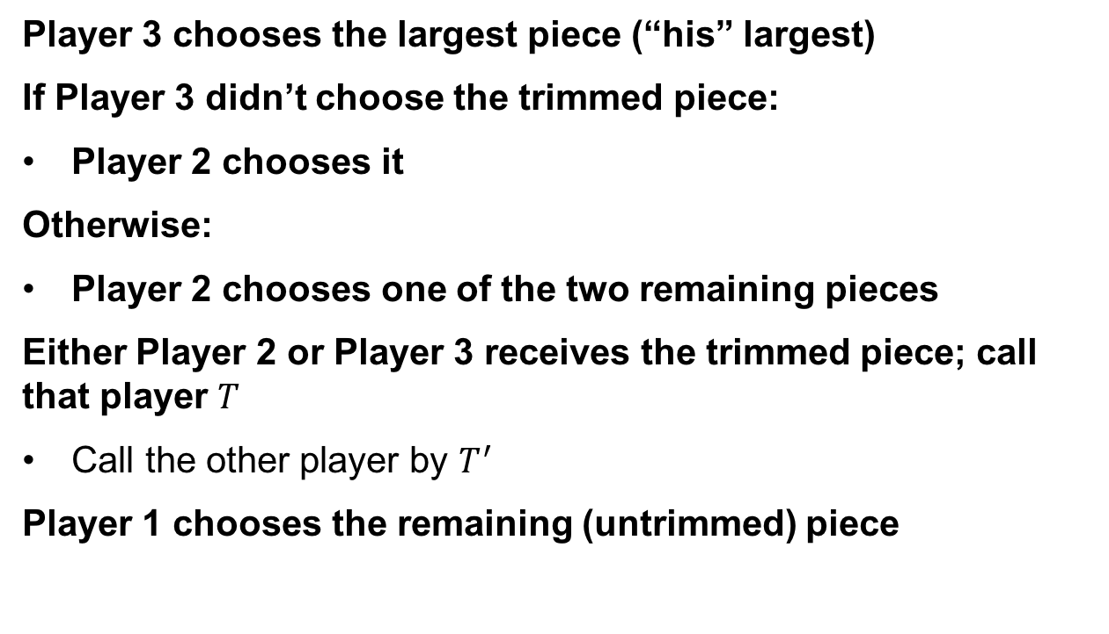
Stage 1: division of Cake 1
Player 3 chooses the largest piece (“his” largest)
If Player 3 didn’t choose the trimmed piece:
Player 2 chooses it
Otherwise:
Player 2 chooses one of the two remaining pieces
Either Player 2 or Player 3 receives the trimmed piece; call that player $T$
Call the other player by $T^{′}$
Player 1 chooses the remaining (untrimmed) piece

Slide 49
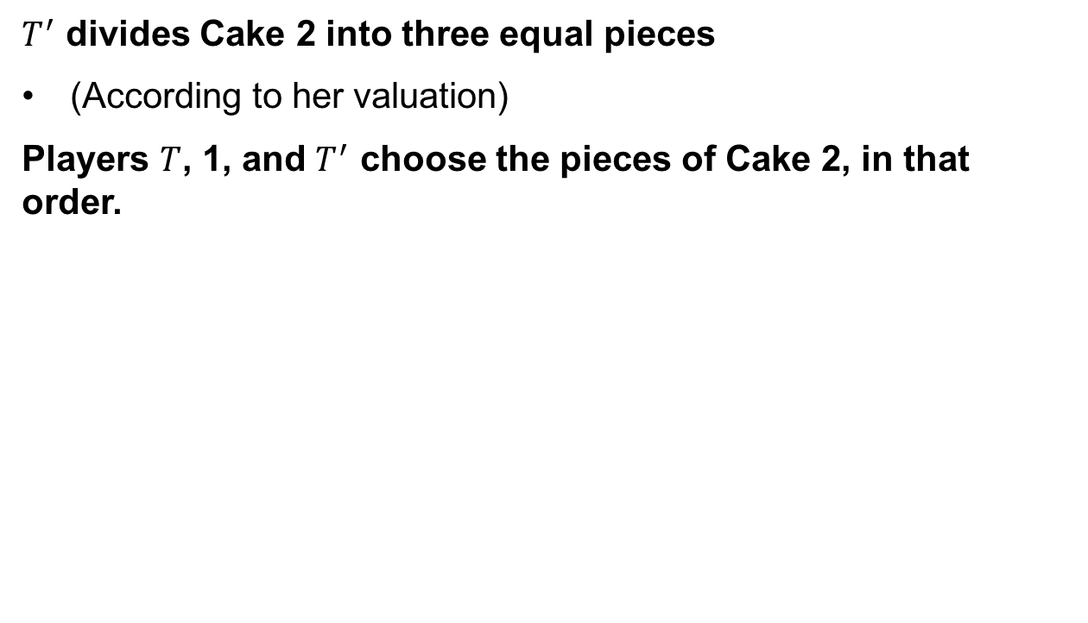
Stage 2: division of Cake 2
$T^{′}$ divides Cake 2 into three equal pieces
(According to her valuation)
Players $T$, 1, and $T^{′}$ choose the pieces of Cake 2, in that order.

Slide 50
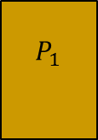
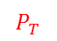
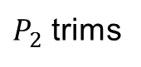
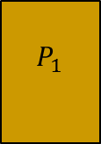
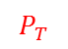
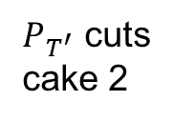
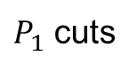
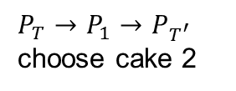

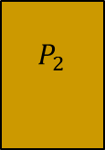
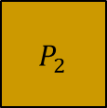
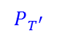
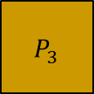
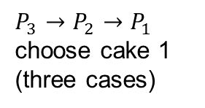

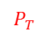
Whole process
$P_{3}→P_{2}→P_{1}$ choose cake 1
(three cases)
$P_{T^{′}}$ cuts
cake 2
$P_{T}→P_{1}→P_{T^{′}}$ choose cake 2
$P_{1}$ cuts
$P_{2}$ trims
Cake 2
$$P_{2}$$
$$P_{2}$$
$$P_{3}$$
$$P_{T}$$
$$P_{T}$$
$$P_{T}$$
$$P_{3}$$
$$P_{1}$$
$$P_{2}$$
$$P_{T^{′}}$$
$$P_{T^{′}}$$
$$P_{1}$$
$$P_{3}$$
$$P_{1}$$
$$P_{T^{′}}$$

Slide 51
Envy-freeness
The division of Cake 1 is envy-free:
Player 3 chooses first so he doesn’t envy others.
Player 2 likes the trimmed piece and another piece equally, both better than the third piece. Player 2 is guaranteed to receive one of these two pieces, thus doesn’t envy others.
Player 1 is indifferent judging the two untrimmed pieces and indeed receives an untrimmed piece.

Slide 52
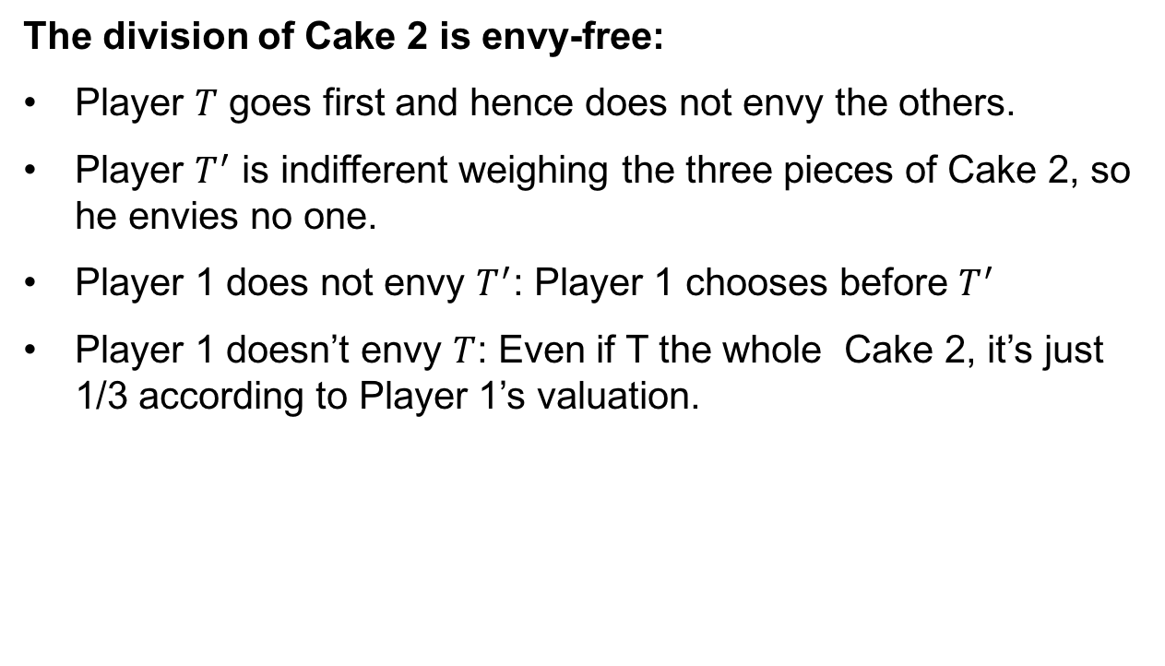
Envy-freeness of Cake 2
The division of Cake 2 is envy-free:
Player $T$ goes first and hence does not envy the others.
Player $T^{′}$ is indifferent weighing the three pieces of Cake 2, so he envies no one.
Player 1 does not envy $T^{′}$: Player 1 chooses before $T^{′}$
Player 1 doesn’t envy $T$: Even if T the whole Cake 2, it’s just 1/3 according to Player 1’s valuation.

Slide 53
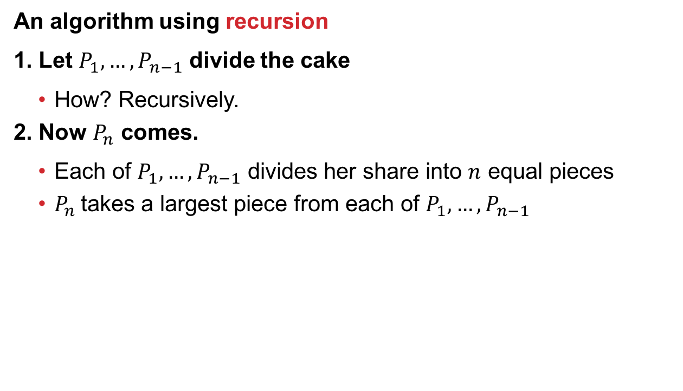

General $n$?
An algorithm using recursion
1. Let $P_{1}, …, P_{n−1}$ divide the cake
How? Recursively.
2. Now $P_{n}$ comes.
Each of $P_{1}, …, P_{n−1}$ divides her share into $n$ equal pieces
$P_{n}$takes a largest piece from each of $P_{1}, …, P_{n−1}$

Slide 54
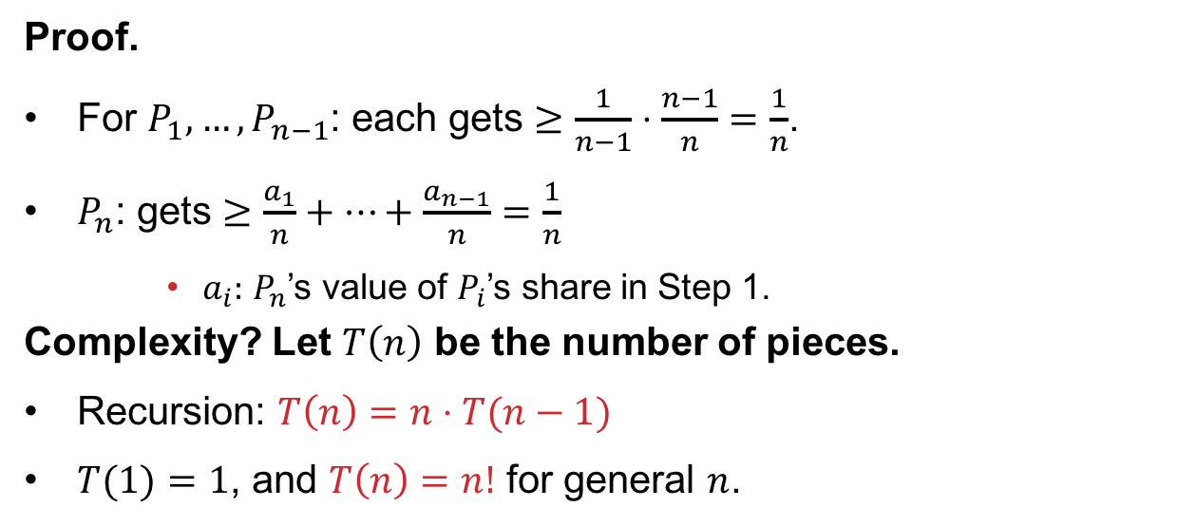
Fairness And Complexity
THEOREM
The protocol is (proportional) fair
Proof.
For $P_{1}, …, P_{n−1}$: each gets $≥\frac{1}{n−1}⋅\frac{n−1}{n}=\frac{1}{n}$.
$P_{n}$: gets $≥\frac{a_{1}}{n}+⋯+\frac{a_{n−1}}{n}=\frac{1}{n}$
$a_{i}:$ $P_{n}$’s value of $P_{i}$’s share in Step 1.
Complexity? Let $T\left(n\right)$ be the number of pieces.
Recursion: $T\left(n\right)=n⋅T(n−1)$
$T(1)=1$, and $T\left(n\right)=n!$ for general $n$.

Slide 55
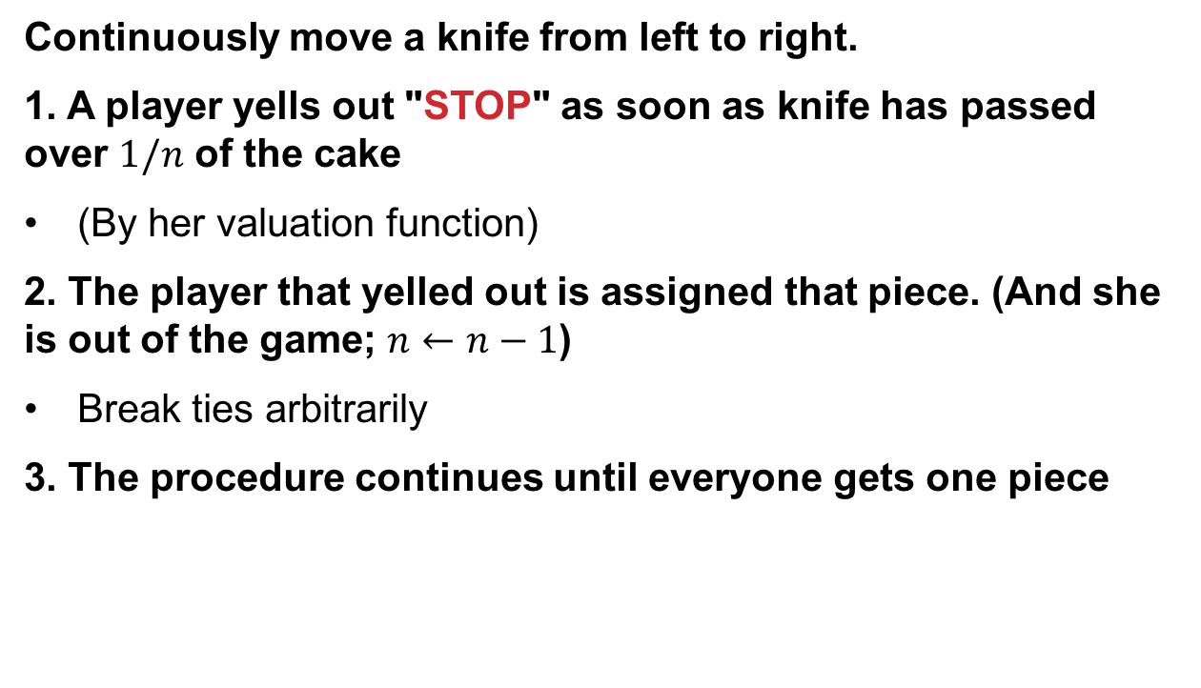
Moving Knife protocols
[Dubins-Spanier 1961]
Continuously move a knife from left to right.
1. A player yells out "STOP" as soon as knife has passed over $1/n$ of the cake
(By her valuation function)
2. The player that yelled out is assigned that piece. (And she is out of the game; $n←n−1$)
Break ties arbitrarily
3. The procedure continues until everyone gets one piece

Slide 56
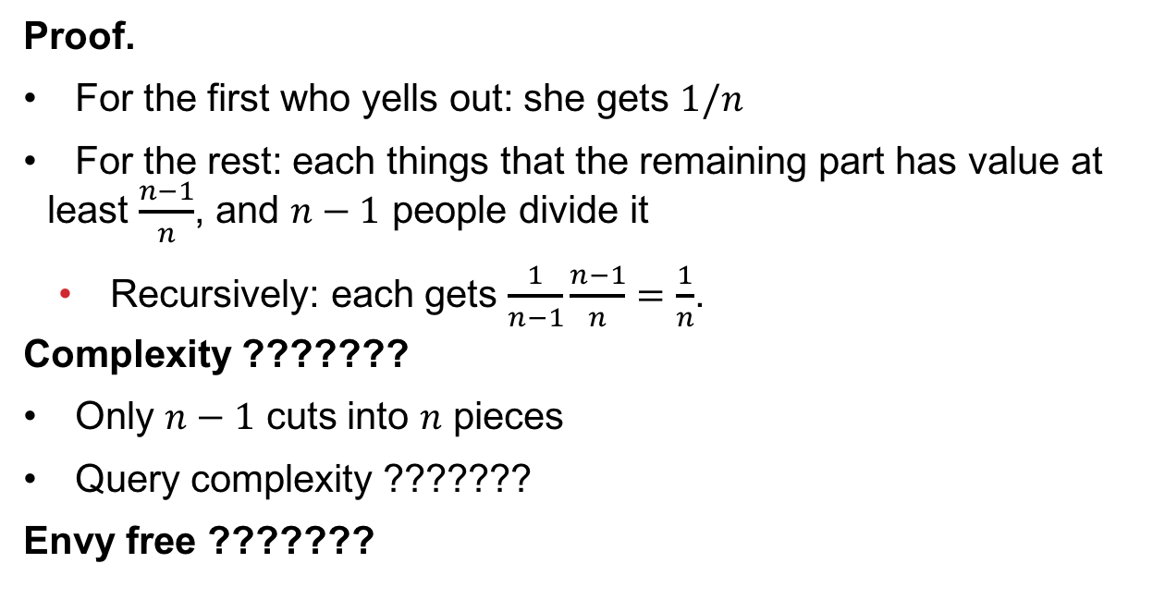
Fairness and complexity
THEOREM
The protocol is (proportional) fair
Proof.
For the first who yells out: she gets $1/n$
For the rest: each things that the remaining part has value at least $\frac{n−1}{n}$, and $n−1$ people divide it
Recursively: each gets $\frac{1}{n−1}\frac{n−1}{n}=\frac{1}{n}$.
Complexity ???????
Only $n−1$ cuts into $n$ pieces
Query complexity ???????
Envy free ???????

Slide 57
What about Fairness vs social welfare?
Player 1
Player 2
Social welfare maximizing allocation ???????
Players 3,4
E-F allocation ????????
Player 1
Player 1
Player 3
Player 2
Player 2
Player 4
Total: 1.5
Total: 2
Fairness ≠ Maximum Utility

Slide 58
The Price of Fairness In Cake Cutting
Given an instance:
max welfare using any division
PoF =
max welfare using fair division
utilitarian
Price of equitability
Price of envy-freeness
Price of proportionality
egalitarian
(= minimum of players’ utilities)

Slide 59
Price of E-F: Continued Example
Player 1
Player 2
Players 3,4
Envy-free
Utilitarian optimum
Total: 1.5
Total: 2
Utilitarian Price of Envy-Freeness: 4/3

Slide 60
“Price Of” Bounds
[Aumann & Dombb]
Price of … | Proportionality | Envy freeness | Equitability
Utilitarian
Egalitarian | 1 |  | 1

Slide 61
Utilitarian Price of E-F: Lower Bound
Player 1
Player 2
Player 3
Player 3
players
Best possible utilitarian:
Best proportional/envy-free utilitarian:
Utilitarian Price of envy-freeness:

Slide 62
CEEI For Multiple Divisible Items
[Varian 1974]
Endow all players with a budget of $1
Competitive equilibrium is:
(Virtual) prices such that …
… when each player buys their most valuable bundle at those prices ...
... the market clears.
Tough to compute
Envy free allocation
(I can afford any other player’s bundle, but chose my own)

Slide 63
Recall: CEEI for Indivisible items?
Two agents
Capacity: 2
Both agents will share the same preference profile:
Market clearing prices
Don’t exist! For any price, for any item, either both agents demand that item or both do not.
Got around this via “A-CEEI,” slightly different budgets for agents, envy free up to 1 good, ~SP in the large …
>
>
>
>
>
>
>
>

Slide 64


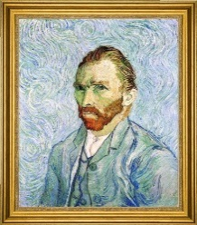




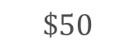
Maximin Share (MMS) Guarantee
Total:
$50
Total: $30
Total: $20
$$\$50$$
$$\$30$$
$$\$3$$
$$\$2$$
$$\$5$$
$$\$5$$
$$\$5$$

Slide 65

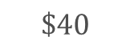

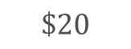
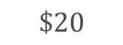

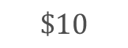
Maximin Share (MMS) Guarantee
Total:
$50
Total: $30
Total: $20
$$\$50$$
$$\$30$$
$$\$3$$
$$\$2$$
$$\$5$$
$$\$5$$
$$\$5$$
Total: $30
Total: $30
Total: $40
$$\$3$$
$$\$2$$
$$\$5$$
$$\$40$$
$$\$10$$
$$\$20$$
$$\$20$$
After Player 1 partitions items into bundles, all other players adversarially choose bundles
What should Player 1 do?

Slide 66
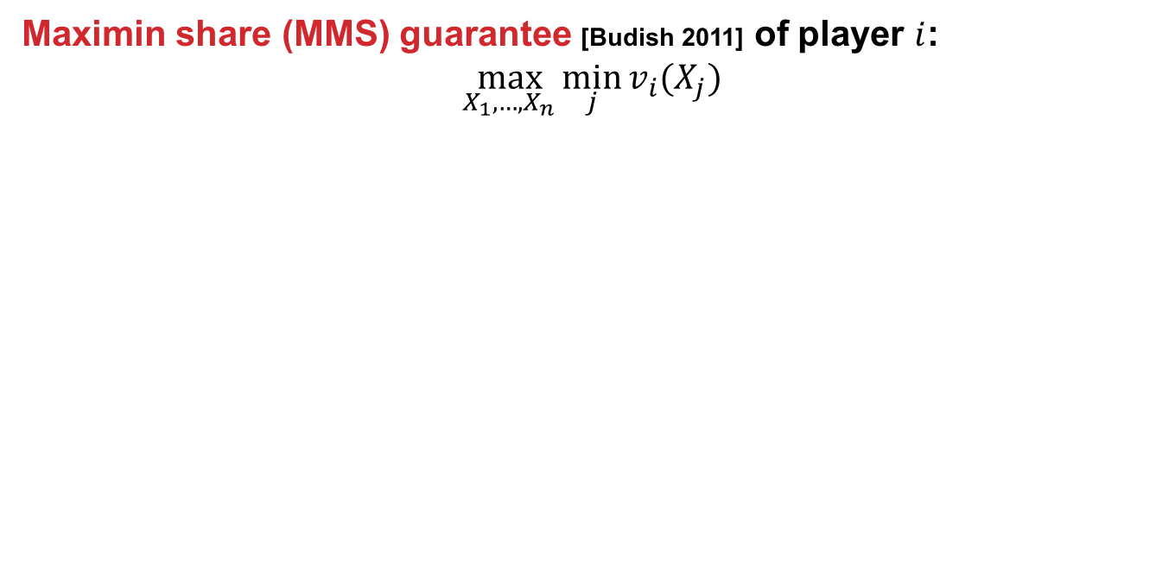
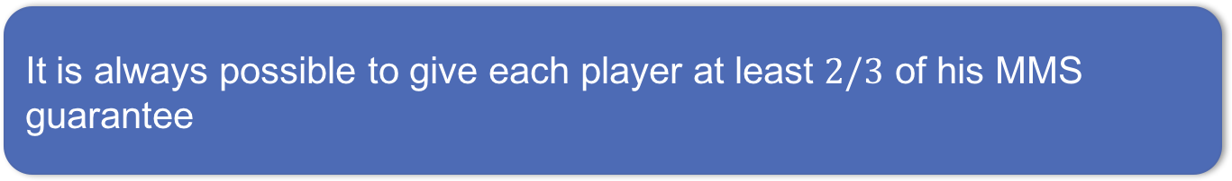
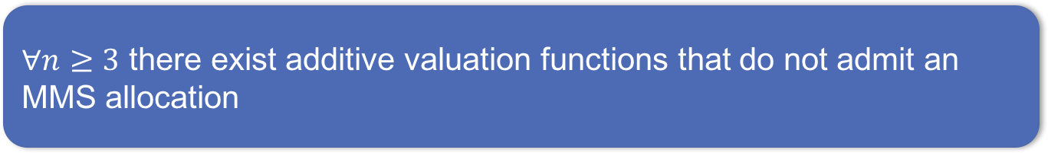
Maximin Share Guarantee
Maximin share (MMS) guarantee [Budish 2011] of player $i$: $$\max_{X_{1},…,X_{n}}{\min_{j}{v_{i}(X_{j})}}$$
THEOREM
$∀n≥3$ there exist additive valuation functions that do not admit an MMS allocation
[Procaccia & Wang EC-2014]
THEOREM
It is always possible to give each player at least $2/3$ of his MMS guarantee
[Procaccia & Wang EC-2014]

Slide 67







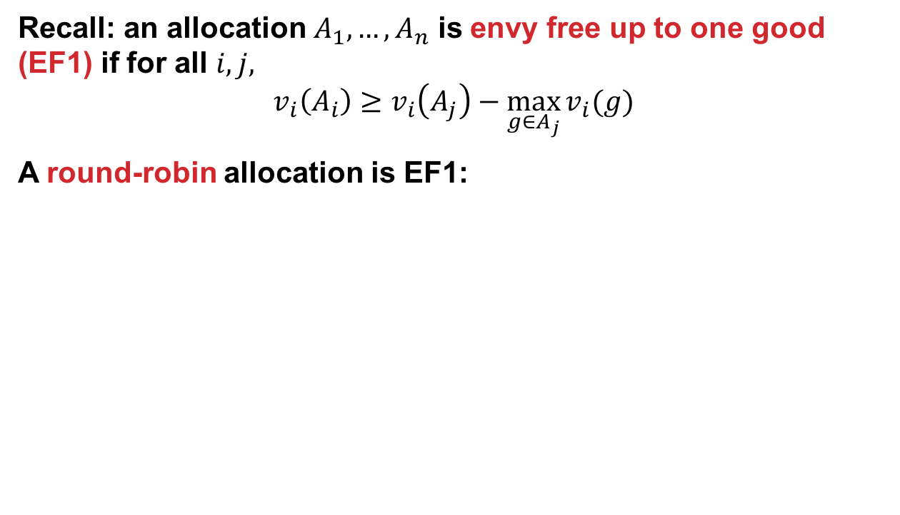
Envy-Freeness up to One Good
Recall: an allocation $A_{1},…,A_{n}$ is envy free up to one good (EF1) if for all $i,j,$ $$v_{i}\left(A_{i}\right)≥v_{i}\left(A_{j}\right)−\max_{g∈A_{j}}{v_{i}(g)}$$
A round-robin allocation is EF1:

Slide 68
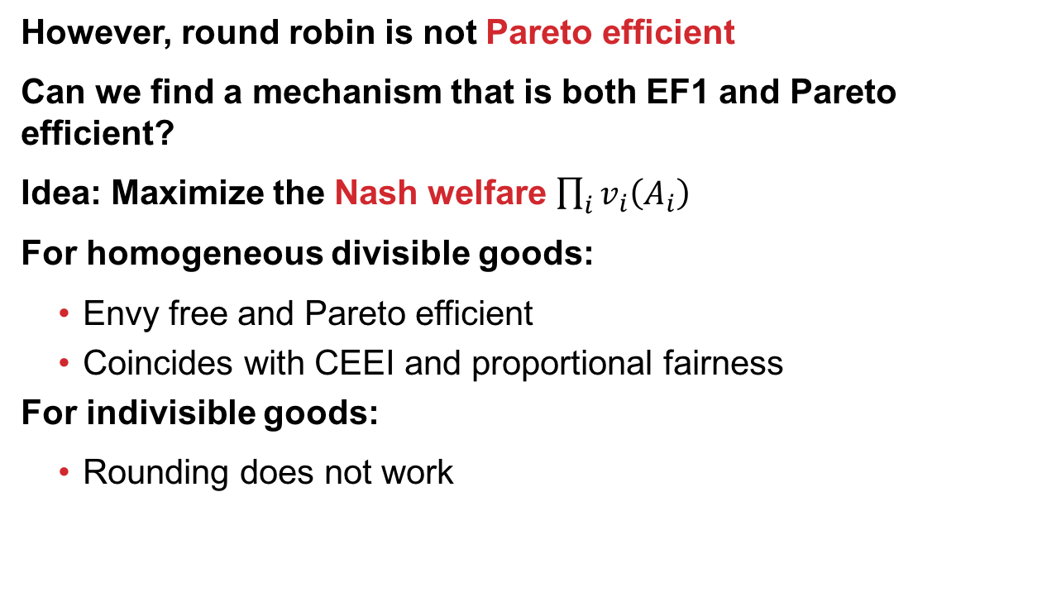
Maximum Nash Welfare
However, round robin is not Pareto efficient
Can we find a mechanism that is both EF1 and Pareto efficient?
Idea: Maximize the Nash welfare $\prod_{i}{v_{i}\left(A_{i}\right)}$
For homogeneous divisible goods:
Envy free and Pareto efficient
Coincides with CEEI and proportional fairness
For indivisible goods:
Rounding does not work
THEOREM
Maximizing Nash welfare satisfies EF1 and Pareto efficiency
[Caragiannis et al. EC-2016]

Slide 69
When do Truly E-F allocations exist?
Can we characterize when an EF allocation of indivisible goods exists (with high probability)?
[A1]: utilities are drawn I.I.D.
[A2]:
each agent equally likely to want g the most
difference between the expected utility of the agent most wanting g and any other agent is at least some constant μ
Uniform distribution satisfies [A1] and [A2]
Goods with intrinsic base values → only [A2]

Slide 70
A small number of goods
THEOREM
Even when the number of goods is larger than the number of agents by a linear fraction, an EF allocation probably won’t exist.
[Dickerson et al. AAAI-14]
Note: if m < n, clearly no EF allocation exists.
How many additional goods beyond m=n are needed?
Formally: under [A1], for small constant δ:
if the probability that EF allocation exists is 1-δ
then m ≥ (1+c(δ))n, with c(δ)>0

Slide 71



A small number of goods
Thought: If two agents want the same good the most, require at least three goods for an envy-free allocation
Count such collisions; are there too many?

Slide 72
A large number of goods
THEOREM
When the number of goods is larger than the number of agents by a logarithmic factor, an EF allocation probably exists.
Formally: under [A2], with n = O(m/ln m):
An EF allocation exists (w.p.1) as m → ∞
Idea: give each good to the agent who wants it the most
This produces EF allocations with high probability

Slide 73
A large number of goods
Proof of the theorem uses a natural mechanism that also maximizes social welfare over the space of allocations
Alternate theorem statement:
THEOREM
“When the number of goods is larger than the number of agents by a logarithmic factor, the social welfare-maximizing allocation is EF.”

Slide 74
Experimental validation
Both theorem statements hide constants
When do these results “kick in”?
We test under two distributions:
Uniform
Satisfies [A1] and [A2] and thus both theorems
Correlated (goods have intrinsic values)
Satisfies [A2] and thus Theorem 2
Hold n constant, vary m, see when EF allocations exist
And how long it takes to find them (or prove otherwise)

Slide 76
Number of agents (x-axis) vs. number of items (y-axis) before at least 99% of the instances had an EF allocation, for each of the Uniform and Correlated distributions.
Theorem 2: w.h.p. occurs when n = O(m/ln m) – aligns with results.

Slide 77
Exploring the phase transition
Is the runtime spike an artifact of the model?
Tried two models in the paper:
Feasibility problem (Model #1)
Optimization problem (Model #2)
Motivation: state-of-the-art IP solvers treat feasibility and optimization problems differently
Some evidence that adding objective can help (e.g., the “MIP Nash” paper [Sandholm Gilpin Conitzer 2005])

